Slide 1
Deep Learning Enhanced CFD
For Modeling External Flow
Guide: Dr. R B Anand
Adithya B
Gokulnath S
Hirthick Kumaran N
Notes:
So, the main objective of our project is to design a deep learning model that could predict the solutions of differential equation that govern the physics laws. To be more specific with the domain, we choose the fluid equations that include the convection-diffusion to start with and end with the ultimate navier stokes eqn.

Slide 2
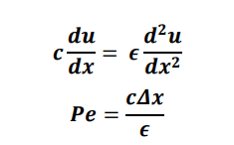

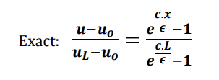
1D Convection Diffusion using CFD
Governing equation
where Pe denotes Peclet number
Solution
Notes:
Solving one dimensional steady advection diffusion equation is a base problem to start because it is time invariant and linear. Conventionally, convection diffusion equation could be solved using central difference scheme.
We started solving the convection diffusion eqn by the conventional cfd method. Here we use the CDS to solve. Cds is the central difference scheme. So this the central differencing scheme is a finite difference method that optimizes the approximation for the differential operator in the central node of the considered patch and provides numerical solutions to differential equations.

Slide 3
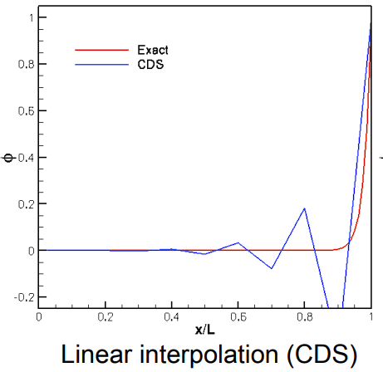
Limitation
For local Peclet number > 2, scheme becomes highly unstable
Accuracy lesser for low order interpolation function
Computation power and time consuming for higher order methods
Somewhat more dissipative
Normal CFD process in larger PDEs are time consuming

Slide 4
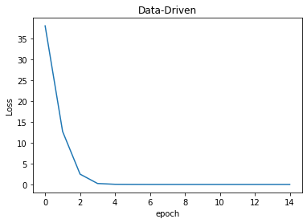
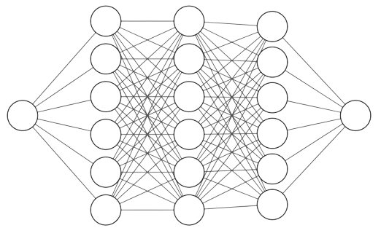
Methods - 1D steady state
Data-Driven
Training data - 0.1<Pe<0.67
Predicted data - Pe=0.5, 2, 4
Architecture
3 hidden layers with 32 neurons in each layer
Input - Solution using CDS scheme
Output - Corrected Solution
What this NN does?
Obtain corrected solution
High fidelity solution data

Slide 5
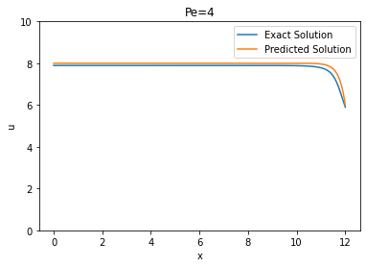
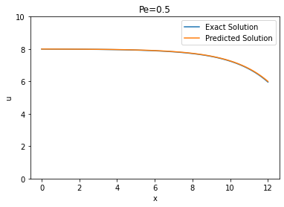
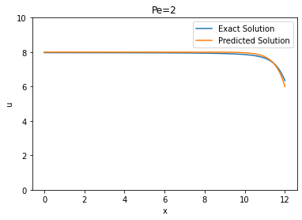
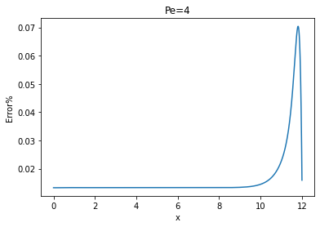
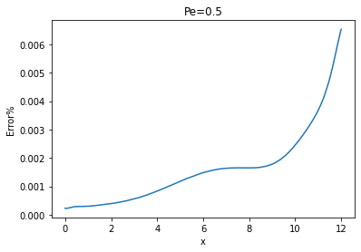
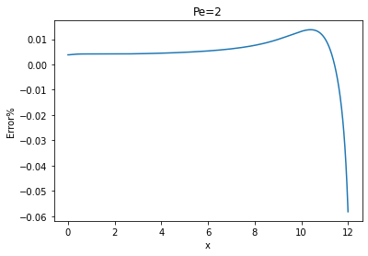

Slide 6
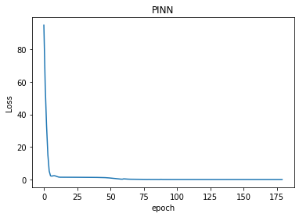
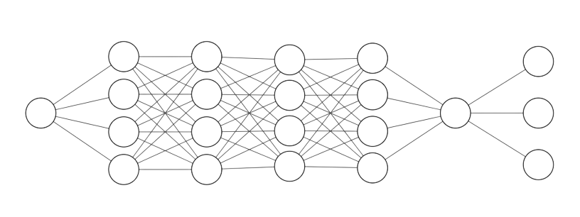
Methods - 1D steady state
2. PINN
Custom weighted loss function
Boundary loss, governing equation loss, collocation loss
NN architecture
Input - x position
Output - u solution
7 Hidden layers with 64 neurons per layer

Slide 7
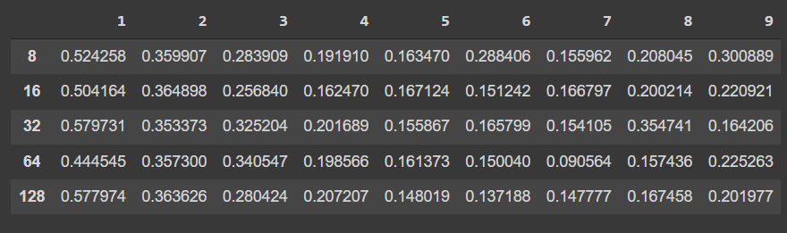
Number of Hidden Layers, Neurons Vs Loss
Number of Hidden Layers
Number of neurons

Slide 8
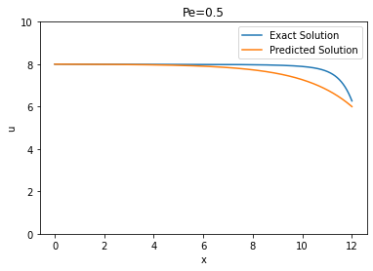
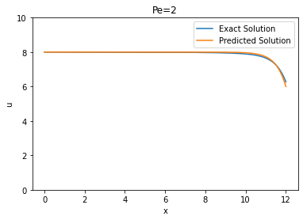
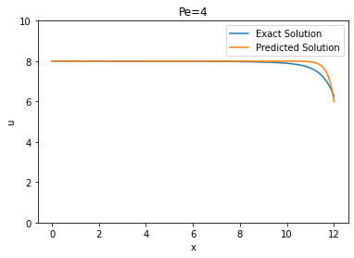
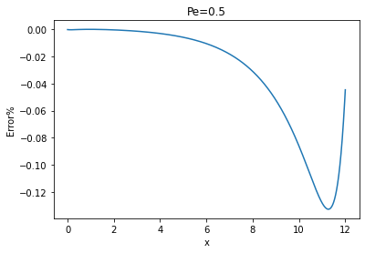
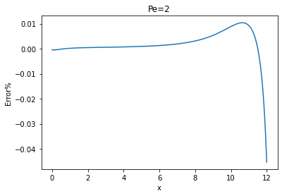
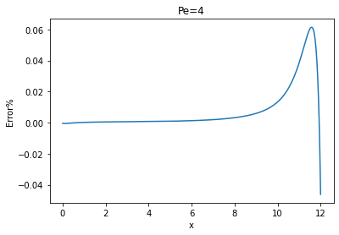
180 Epochs

Slide 9
Data-Driven VS PINN
 | Data-Driven | PINN
Training data size | 500x10 | 1x10
Data preparation time | 9s | <1s
Epochs | 15 | 180
Final error | 0.1405 | 0.0309
Training time | 8s | 14s

Slide 10
2D Convection Diffusion- PINN
NN architecture
Input - x, y
Output - u (obtained using Hybrid scheme)
Loss function - Similar to 1D PINN
8 Hidden layers with 64 neurons per layer
L2 error was calculated to be 0.1574 in the end
Why NN?
Converts low-fidelity to high-fidelity data
Notes:
For 2D convection diffusion, we can no longer employ exact solution. Hence we adopt the hybrid scheme in Finite Volume Method to produce the data. The network input is now x and y. We use data from a 10x10 mesh for training and 20x20 mesh as collocation points.

Slide 11
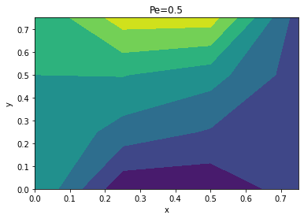
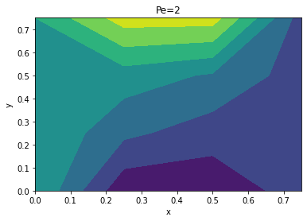
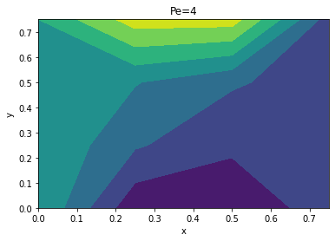
Training Data
Pe = 0.5
Pe = 2
Pe = 4

Slide 12
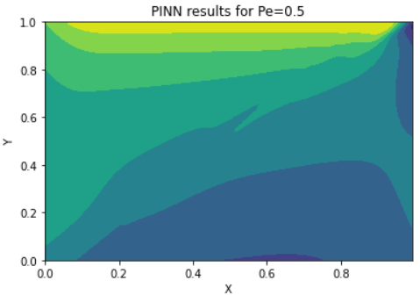
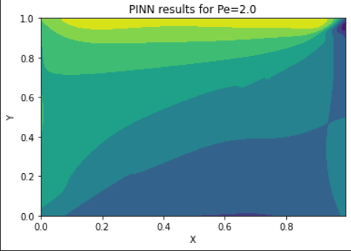
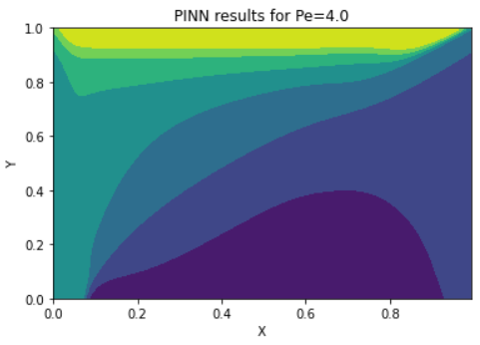
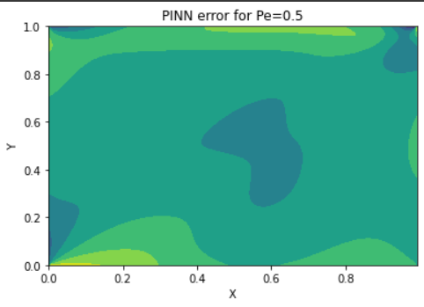
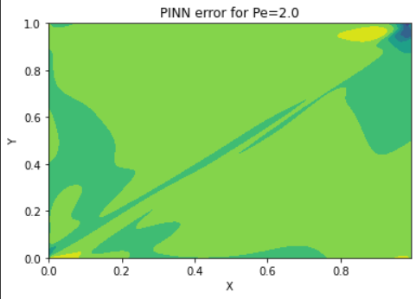
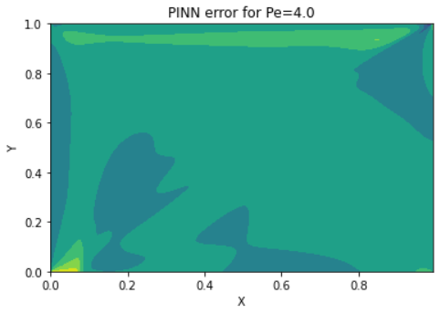
Results

Slide 13
THANK YOU!

Slide 16

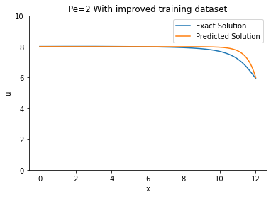

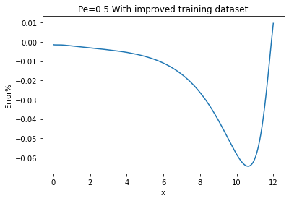
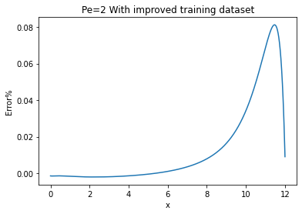
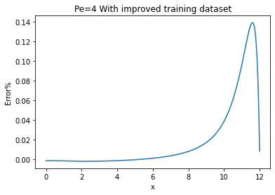
PINN-With Improved Training Dataset
90 epochs

Slide 17
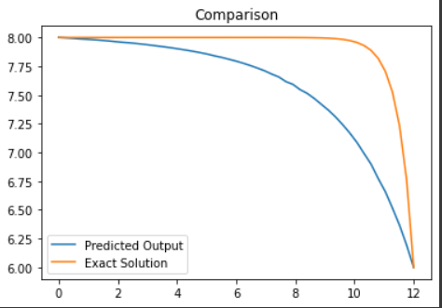
ML in convection-Diffusion
The results we found were as follows:
Initial Error: 3.511
Final Error : 0.216
Thus we see a 16x improvement which can only improve with deeper architectures.
Notes:
….and these were the results we found. For the 1D convection diffusion problem where the initial boundary condition was 8 and the final boundary condition is 6, the initial error was found to be unimpressive 3.5…. This is the error in the CDS solution compared to exact solution. This is proof that we require high fidelity data without compromising computational expenses. Fortunately machine learning does an impressive job in making these less accurate solutions. CDS solutions to exact solution. We see that the error in the network prediction is now a minimal 0.216, a 16x improvement. This number can still be improved by training a deeper network.

Slide 18
Limitations in using ML
Obtaining a rich and sufficient dataset from simulations for training a reliable ML model is computationally expensive.
There is also very limited amount of high fidelity data available.
Data driven deep learning models are black boxes.
Notes:
Yet, there are a few bottlenecks in adopting traditional machine learning methods to solve CFD. In the architecture we presented, it can be found that the input size is fixed. This means the network works for a fixed mesh size. To train the model for a finer mesh size, we require data pertaining to those finer mesh, atleast during training. And that is exactly the biggest bottleneck one would face while using traditional machine learning to solve CFD.
We started this project with an objective to significantly reduce computational expense and yet have end up in a position where we do require those computational expensive CFD solutions, atleast during training.
Another bottleneck is that deep learning models are black boxes. it's pretty impossible to get any insight about the learnt function from the parameters. There is a limit to how much we can learn from them.
This is the reason we arrive at Physics Informed Neural Networks, or shortly, PINNs.

Slide 19
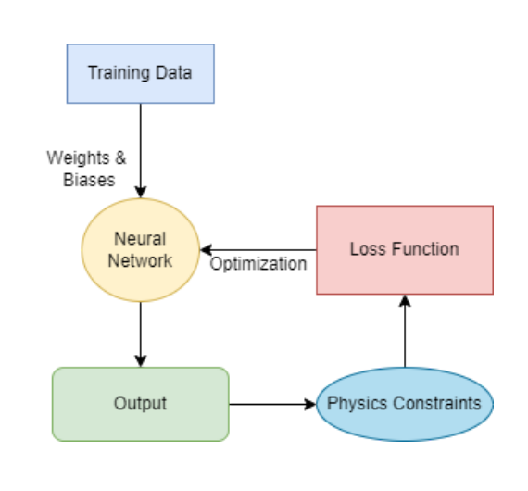
PINN- Physics Informed Neural Network
The usual neural networks are based on data that are fed.
There is no need for understanding the physics behind the problem to train a neural network.
It is essential to make the neural network function learn the physics of the problem.
Notes:
As there are still some limitations using ML in solving physics eqn, here is where PINN comes into pic. Physics-informed neural networks (PINNs) are a type of universal function approximators that can embed the knowledge of any physical laws that govern a given data-set in the learning process, and can be described by partial differential equations (PDEs). They overcome the low data availability in training the ML models. make the neural network function learn the physics of the problem.

Slide 20
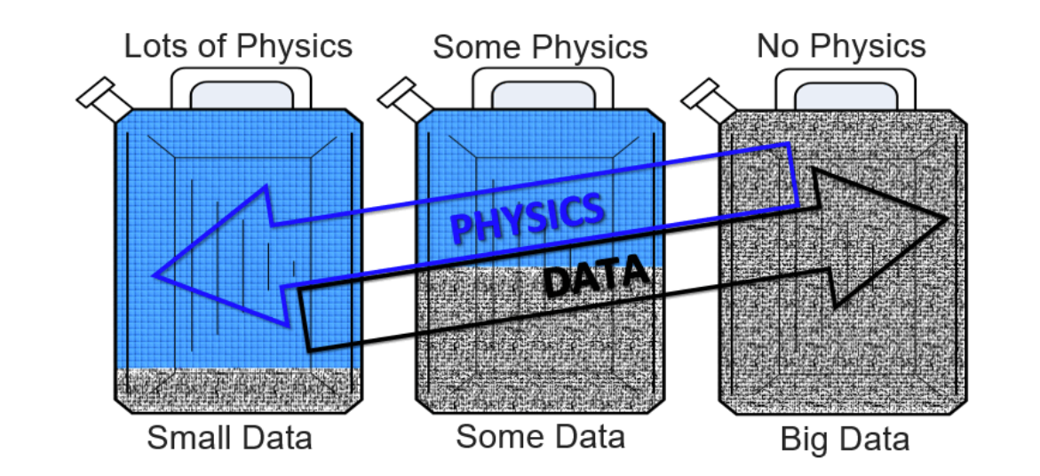
PINN
We introduce physics informed neural networks – neural networks that are trained to solve supervised learning tasks while respecting any given law of physics described by general nonlinear partial differential equations.
Notes:
As shown in the picture, with some data and some physics we could train a better model. In our case, as we are using PDEs that govern physical laws, we use this PINN to help with data availability and at same time help the model to be more aligned with the physical nature of the equations. Hence in the convection diffusion model we adopt this PINN and input BC and PDE loss together to get more accurate results.

Slide 21
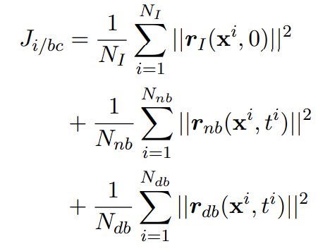
1D Convection Diffusion- PINN
Independent variables, X, are given as input to train the model to solve 1D Convection Diffusion in steady state conditions. To generate output, the PDE is solved analytically.
The model is trained until no significant reduction in loss is observed.
In addition to the mean squared error, the loss function includes PDE loss (Ji/bc), where r(.) specifies the PDE residues.
Notes:
With PINNs, we first solve 1D and 2D convection diffusion before eventually solving Navier Stokes equation. One huge advantage of PINN is that it can be trained on coarser mesh, which isn’t expensive to compute but can be used to predict finer mesh grid values because by that time, the network would have learnt to know that any prediction must satisfy the governing equations. We’ll today, in our presentation talk about 1D and 2D convection diffusion alone.
So, this is how it works:

Slide 22
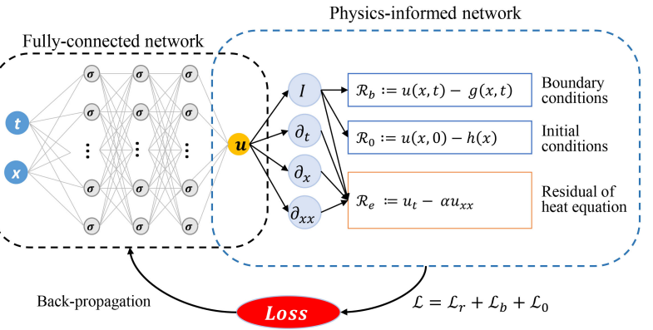
1D Convection Diffusion- PINN
Notes:
This is a picture of a generalistic PINN model. We use fully connected layers to estimate the output variable. In general the inputs are the independent variables, x, y and t.
For 1D convection diffusion problem under steady state condition, those inputs are simply x. After output is predicted, automatic differentiation can be used to calculate the spatial derivatives of the output.
In addition to the mean squared error, we deploy another loss functions, one for boundary conditions and the other for the governing equation.
We use three kinds of data for training.
One, we use data from coarser mesh to train the model. In our study, the study domain was divided into 100 finite volumes. Mean squared error of the predicted output variable to the exact solution is calculated for the loss. This will be the network loss.
Second, boundary points are used for the network to learn the boundary conditions. This can be both Neumann or dirichlet although in our case, they are both Dirichlet. Again, mean squared error is used to calculate the loss. This will be the boundary condition loss.
Lastly, we use collocation points for the network to learn the governing equation. In our study, we use 500 collocation points for this purpose. In the governing equation, if we take all terms to the left, RHS is 0. During prediction, any residue that ends up in the RHS instead of zero can be considered as the network’s error in satisfying the governing equation. This residue can be used to calculate the PDE loss.
The final loss is the sum of all these individual losses.

Slide 23
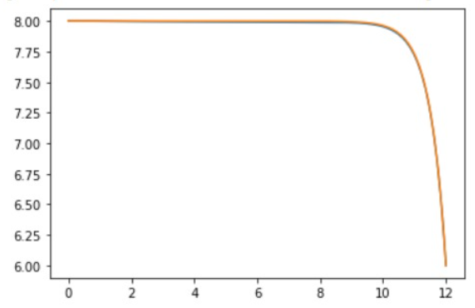
1D Convection Diffusion- PINN
The optimal architecture was discovered to be a dense network with 8 hidden layers with 64 neurons each, after varying the depth of the network and the number of neurons in the hidden layers.
Because of its zero-mean feature, Tanh was chosen as the activation.
L2 error was calculated to be 0.0072 in the end.
The yellow curve denotes the actual curve while the blue sign denotes the output predicted by the network.
Notes:
To find the optimal architecture, we trained the network after varying the number of hidden layers from 1 all the way to 9 and simultaneously varying the number of neurons each hidden layer must have, from 8 to 128
Of all these combinations, the optimal architecture was found to be one with 8 hidden layers with 64 neurons each.
Tanh was chosen as the activation function because it has a mean zero. Because the second-order derivative becomes linear, ReLU is no longer applicable.
After training, we predicted for a mega fine mesh with 10000 grid points, What would have taken more than 15 minutes for my laptop to compute, our deep learning model did in less than a second with an appreciably small error of 0.007.
This is a huge save in time with very minimal compromise on accuracy, if any.

Slide 24
ML in convection-Diffusion
A map between CDS solution and exact solution can be easily built using a single layered neural network since CDS and exact solutions can be easily found out.
If a generalized map could be found out, then it could enhance CDS solution for any advection-diffusion problem. This is the key advantage of the model.
Notes:
This is where machine learning comes into picture. If we had a means to estimate a more accurate solution from a given approximate solution, we can end up having the best of both worlds, ie. improved time consumption due to need to compute only an approximate solution and also a significantly accurate end product if the network is trained long enough.
We take the same above example of solving 1D convection diffusion problem to prove this point.
We train a model where the input of the network is the CDS solutions for varying Peclet numbers while the output is the exact solutions solved analytically.
The model maps CDS solution to exact solution.
The model architecture can be seen here. WIth just one hidden layer, a good enough mapping from CDS solution to exact solution can be found out.
One key advantage of the model here is that the model can now work for a wide range of Peclet number.

